Slide 1
Take one of the sheets and write your name down on it, please.

Slide 2
26th of September

Slide 3
How many languages in Europe?
24 official
Over 200 spoken

Slide 4
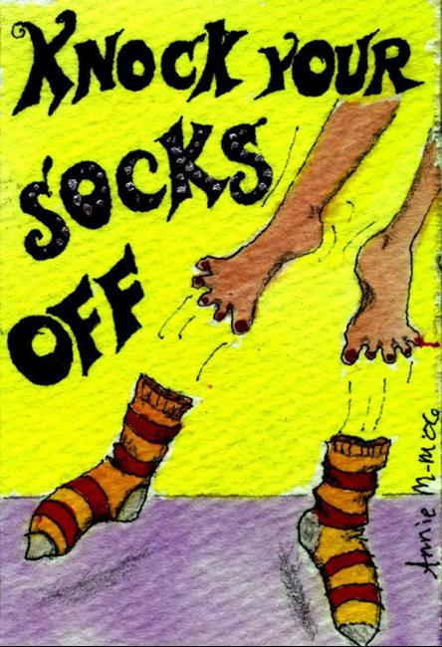
British slang words and expressions to knock your socks off!

Slide 5
To provide the lesson with context.

Slide 6
Quiz
a test of knowledge, especially as a competition between individuals or teams as a form of entertainment.
To familiarize students with the term.
Competition
Entertainment

Slide 7
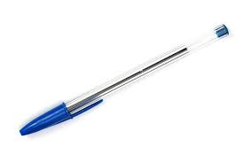
Take pen in hand and try to get as many correct answers as you can!
Ready, steady, go!
Ready, steady, go!

Slide 8
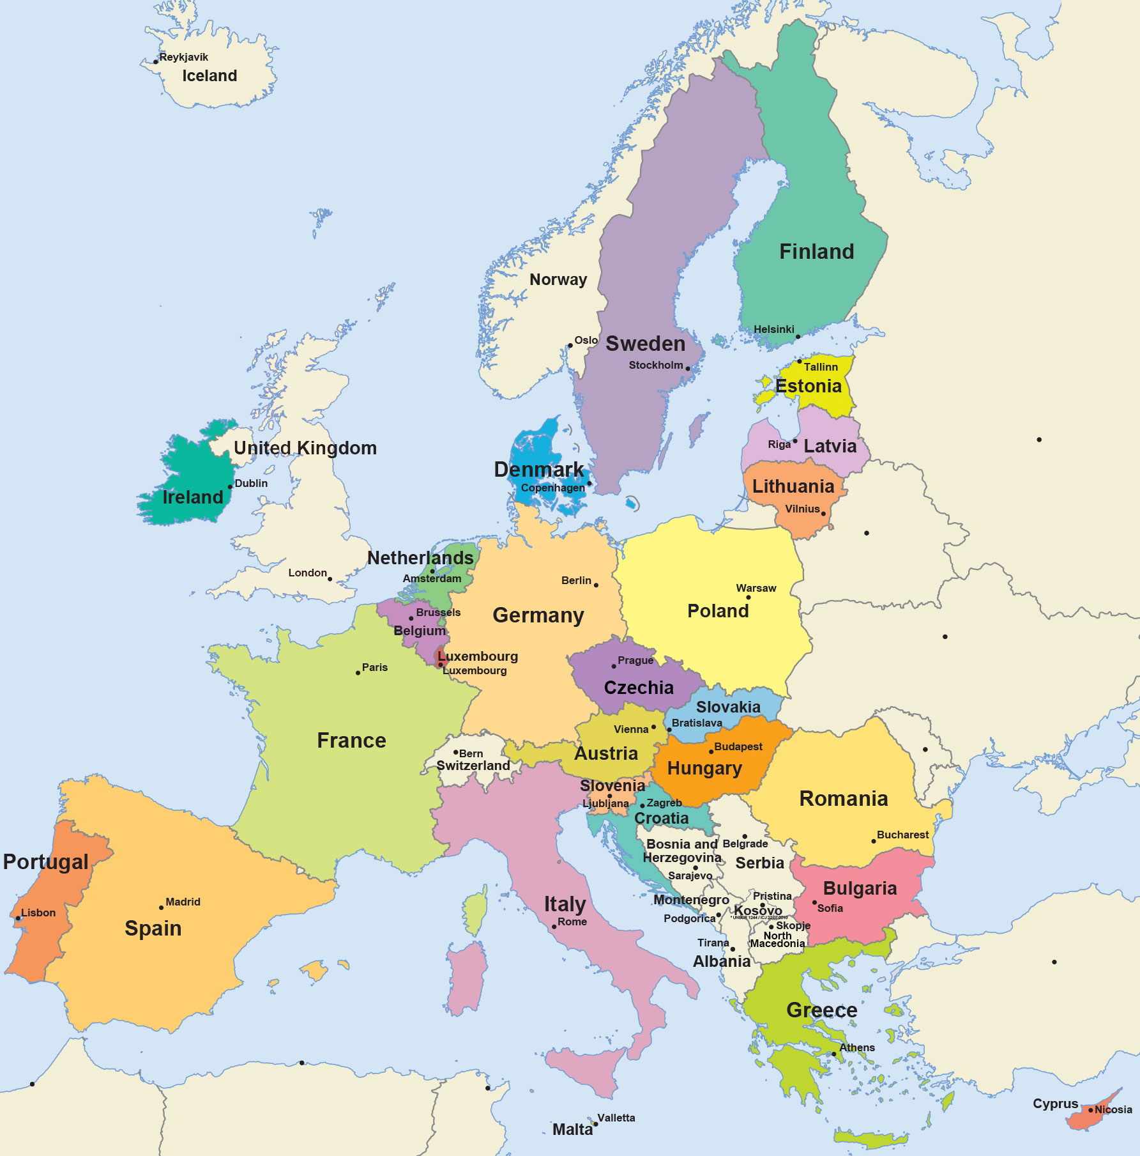
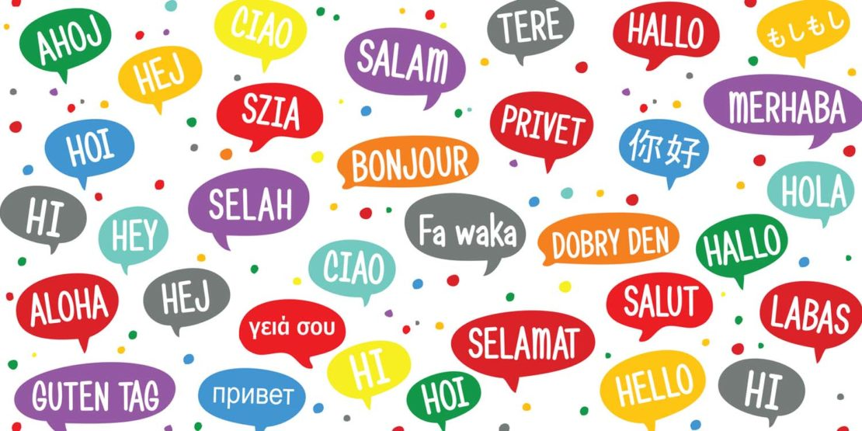
Which is the most widely spoken language in Europe?
English
Romanian
Russian

Slide 9
Hold your horses!
Don’t allow your horses to move.
Slow down and think!

Slide 10
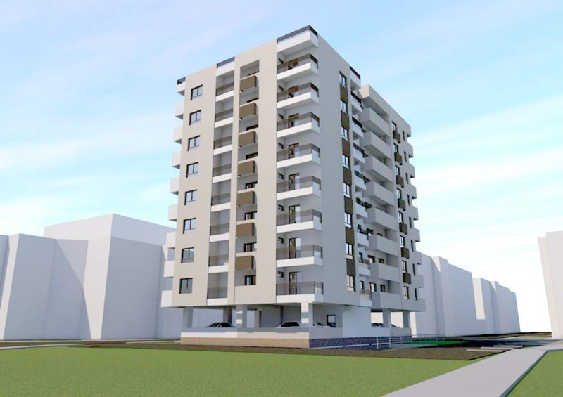
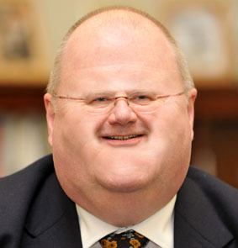
Bloke
Apartment
A man

Slide 11
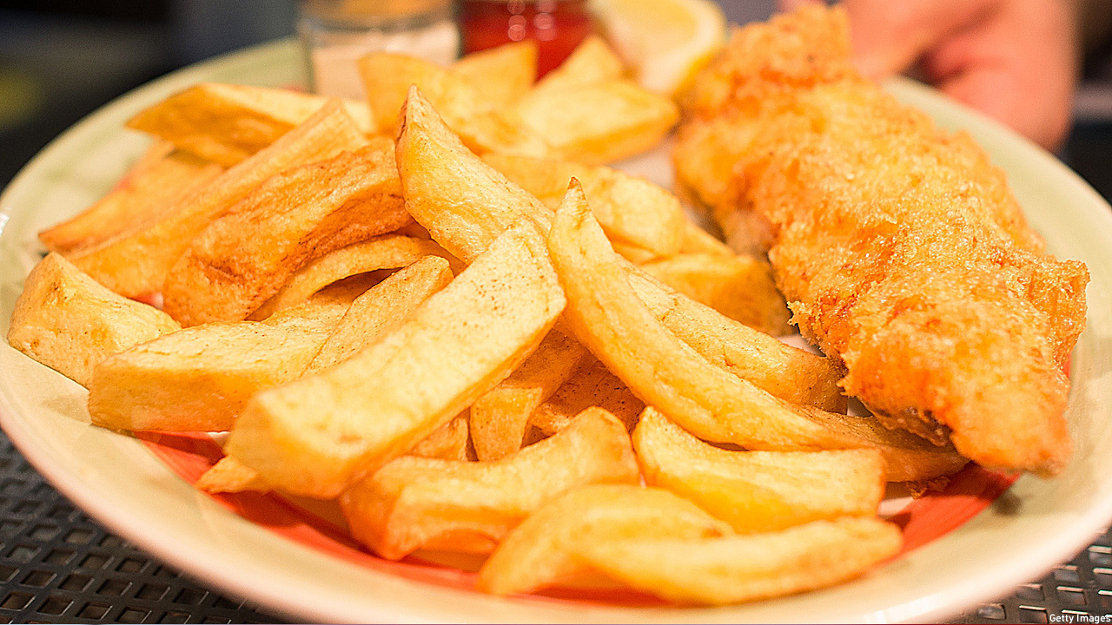
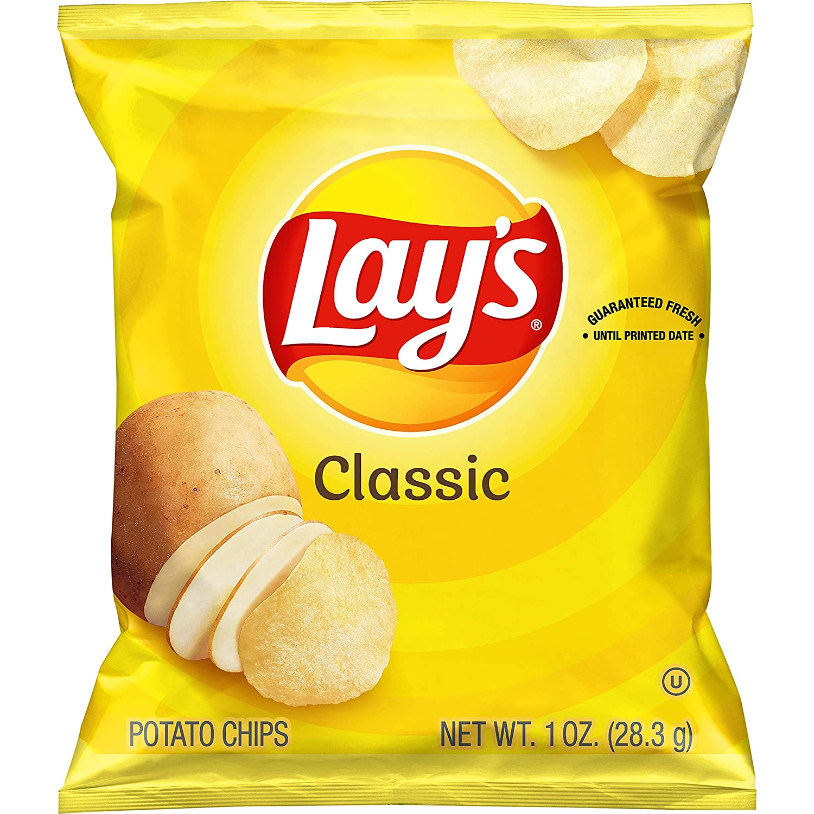
Chips
a. Fries
b. Chips (Lays, Chio Chips)
Notes:
Consider talking about:
In early modern England
In Judaism
In Christianity
In Islam
In Bahai Faith

Slide 12
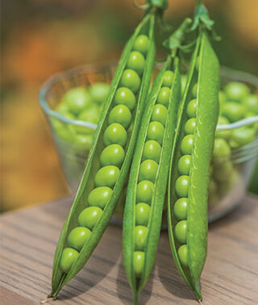
Easy Peasy
Peas
Not difficult
Notes:
Consider talking about:
Evolutionary view
Perception of those who gossip

Slide 13
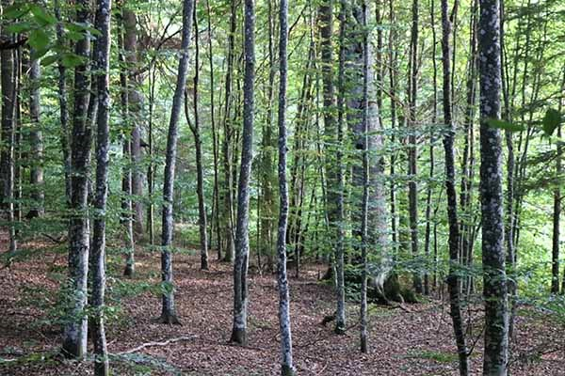
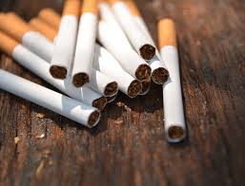
Fag
Cigarette
A tree

Slide 14
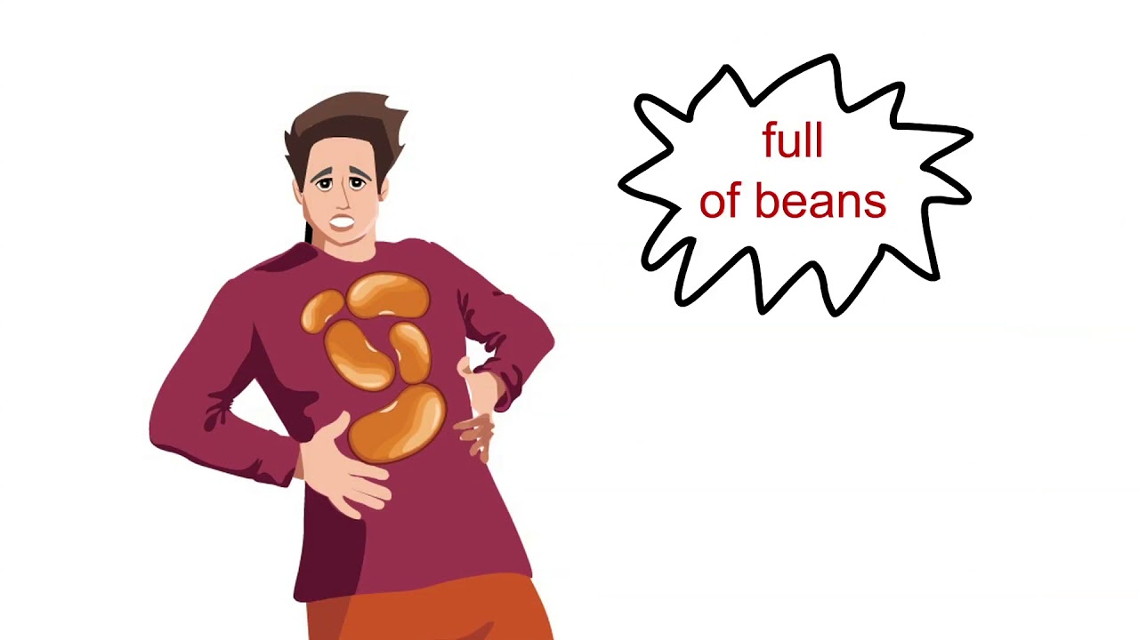
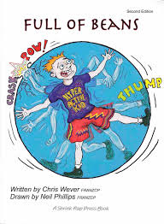
Full of BEANS
Someone who has eaten lots of beans
Someone who is full of energy

Slide 15
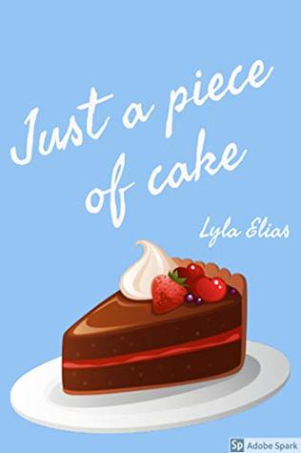
Piece of cake
A piece of cake
Something that is easy to do (easy peasy)

Slide 16
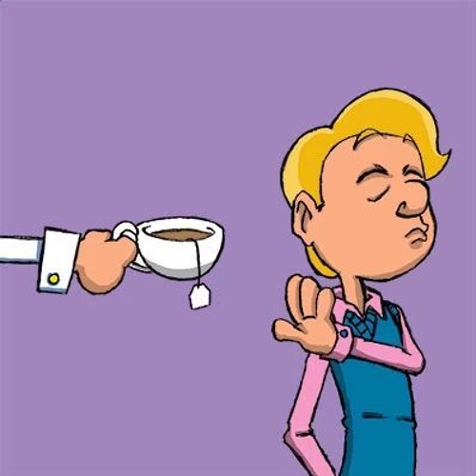
Not my cup of tea
Someone else’s cup of tea
Not what I like or prefer

Slide 17
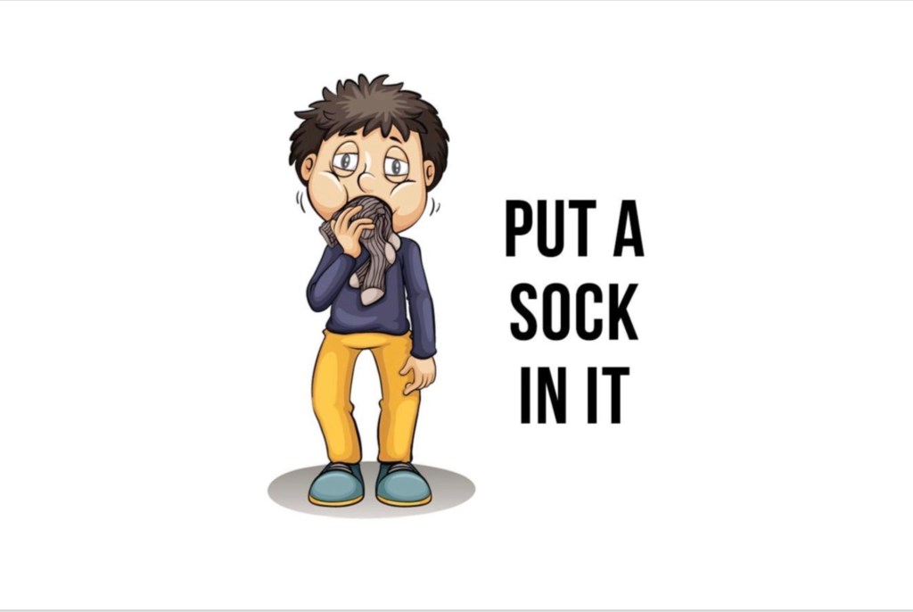
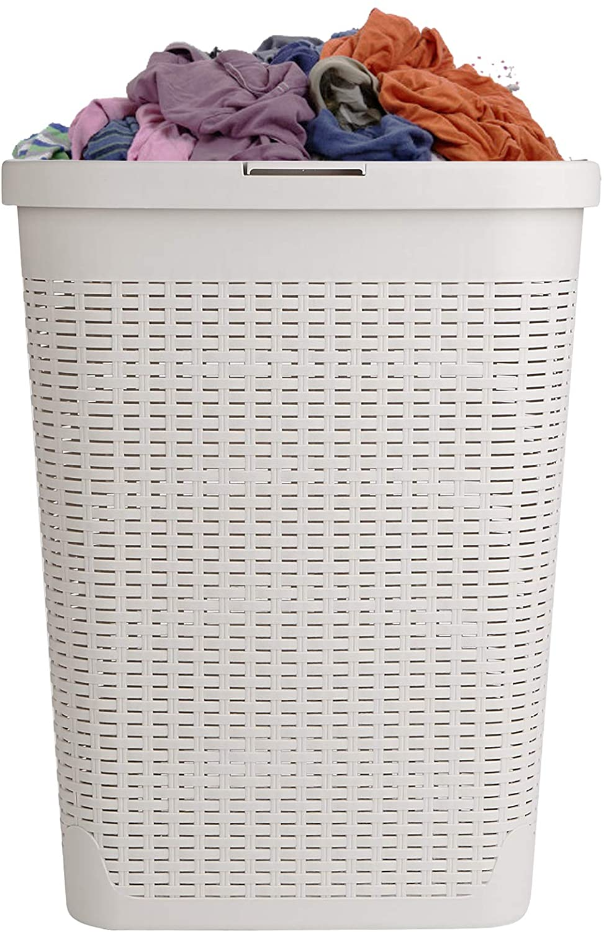
Put a sock in it
Shut up! (Stop talking.)
A laundry basket.

Slide 18
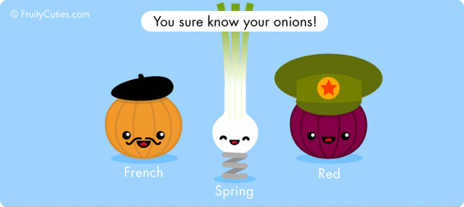
You Know your onions
You know all about onions
You are smart (clever)!

Slide 19
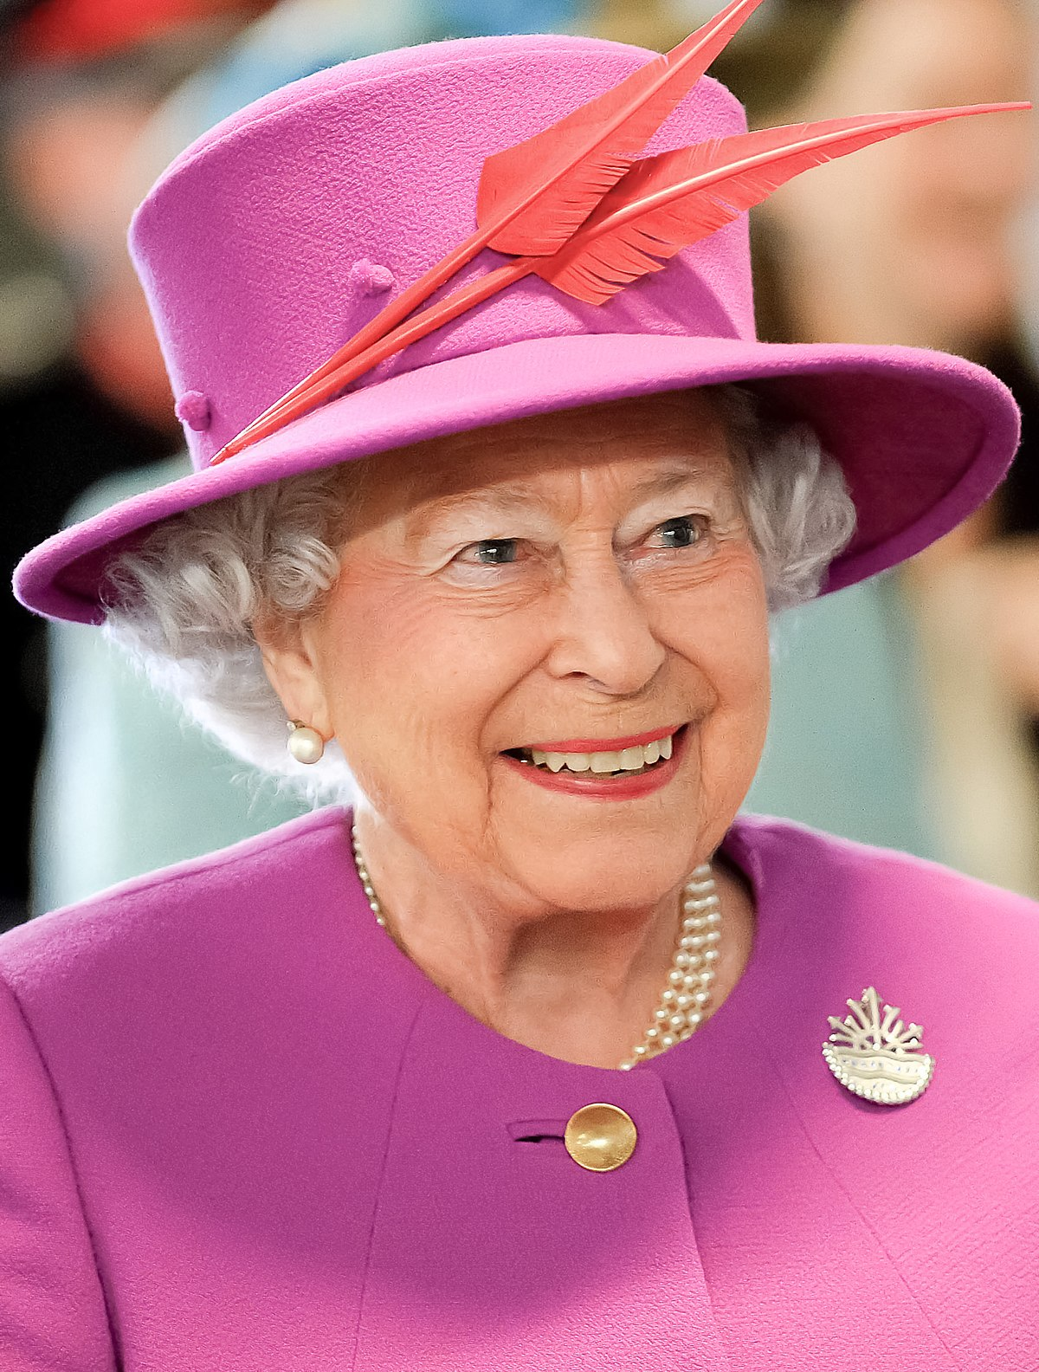
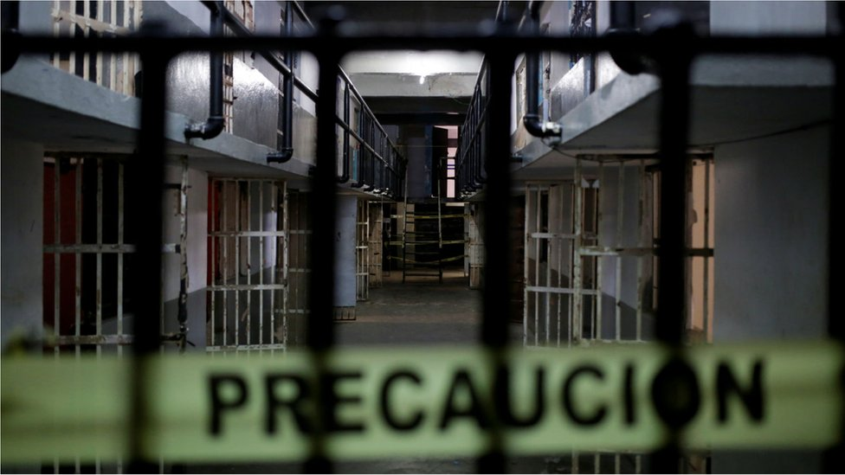
Her Majesty’s Pleasure
Serve time in prison
An invitation to have tea with the Queen

Slide 20
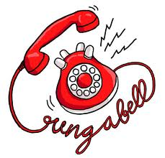
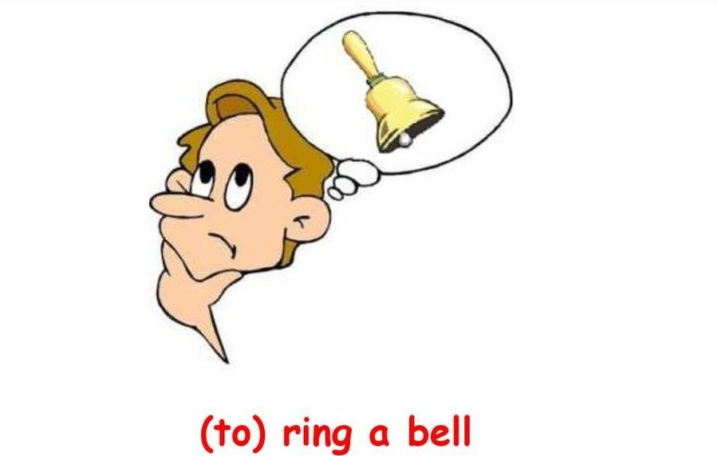
Ring a Bell
a. Use a bell
b. Something that sounds familiar

Slide 21
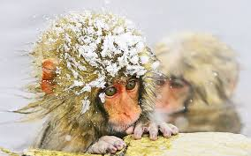
It’s monkeys outside!
It’s freezing! (very cold)
There are many monkeys outside walking around.

Slide 22
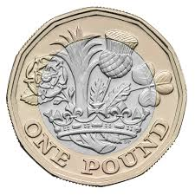
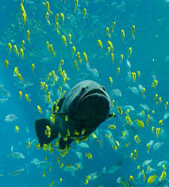
Quid
1 £
A species of fish

Slide 23
Name
Quiz answer sheet
Score
Most widely spoken language in Europe – c. Russian
Hold your horses – b. Slow down and think
3. Bloke – b. A man
4. Chips – a. Fries
5. Easy Peasy – a. Not difficult
6. Fag – a. Cigarette
7. Full of beans – b. Someone who is full of energy
8. Piece of cake – b. Something that is easy to do
9. Not my cup of tea – b. Not what I like or prefer
10. Put a sock in it! – a. Shut up! (Stop talking.)
11. You know your onions – b. You are smart (clever)!
12. Her Majesty’s Pleasure – a. Serve time in prison
13. Ring a bell – b. Something that sounds familiar
14. It’s Monkeys Outside – a. It’s freezing! (very cold)
15. Quid – a. 1 £

Slide 24
Name:
Quiz answer sheet
Score:
1. | 6. | 11.
2. | 7. | 12.
3. | 8. | 13.
4. | 9. | 14.
5. | 10. | 15.

Slide 25
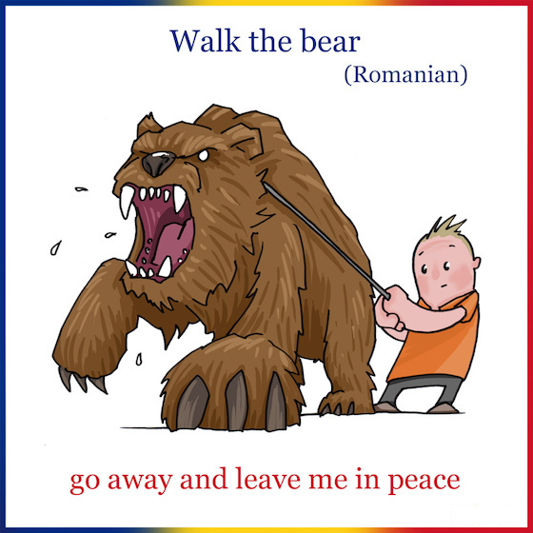
Do we, in Romanian, have any such words or expressions?
Plimbă ursul!

Slide 26
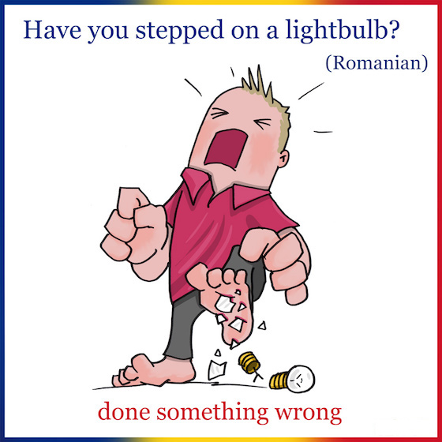
Do we, in Romanian, have any such words or expressions?
A călca pe bec

Slide 27
Do we, in Romanian, have any such words or expressions?
Floare la ureche!

Slide 28
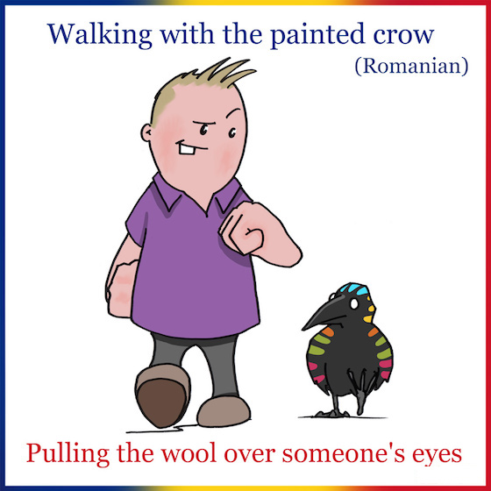
Do we, in Romanian, have any such words or expressions?
A umbla cu cioara vopsită

Slide 29
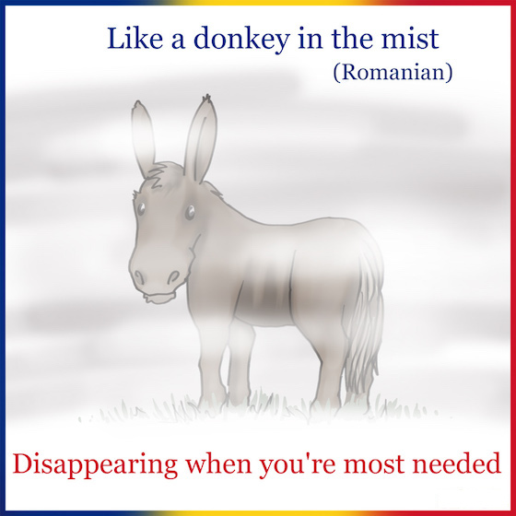
Do we, in Romanian, have any such words or expressions?
A dispărea ca măgaru-n ceaţă.

Slide 30
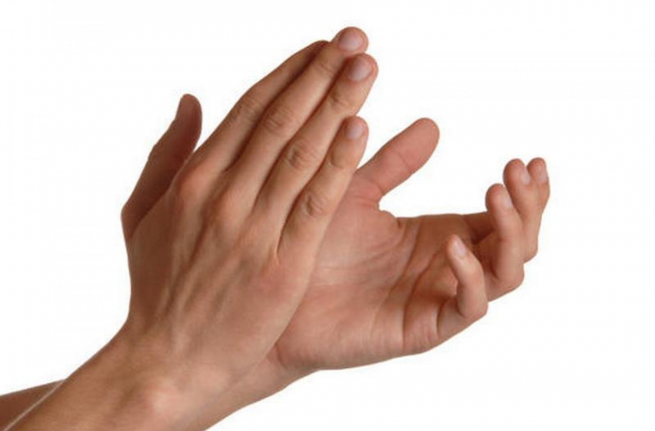
Thank you for your attention!
Now, choose your favourite, write it down on a piece of paper, as neatly as you possibly can, and then try your best and illustrate its meaning. Also, make up a sentence using it.

