Slide 1
INTERACTIVE EXERCISES
using Educaplay tools
prof. Costa Elisabeta Monica
prof. Szabo Florina
ALLPPT.com
Free PowerPoint Templates, Diagrams and Charts

Slide 2
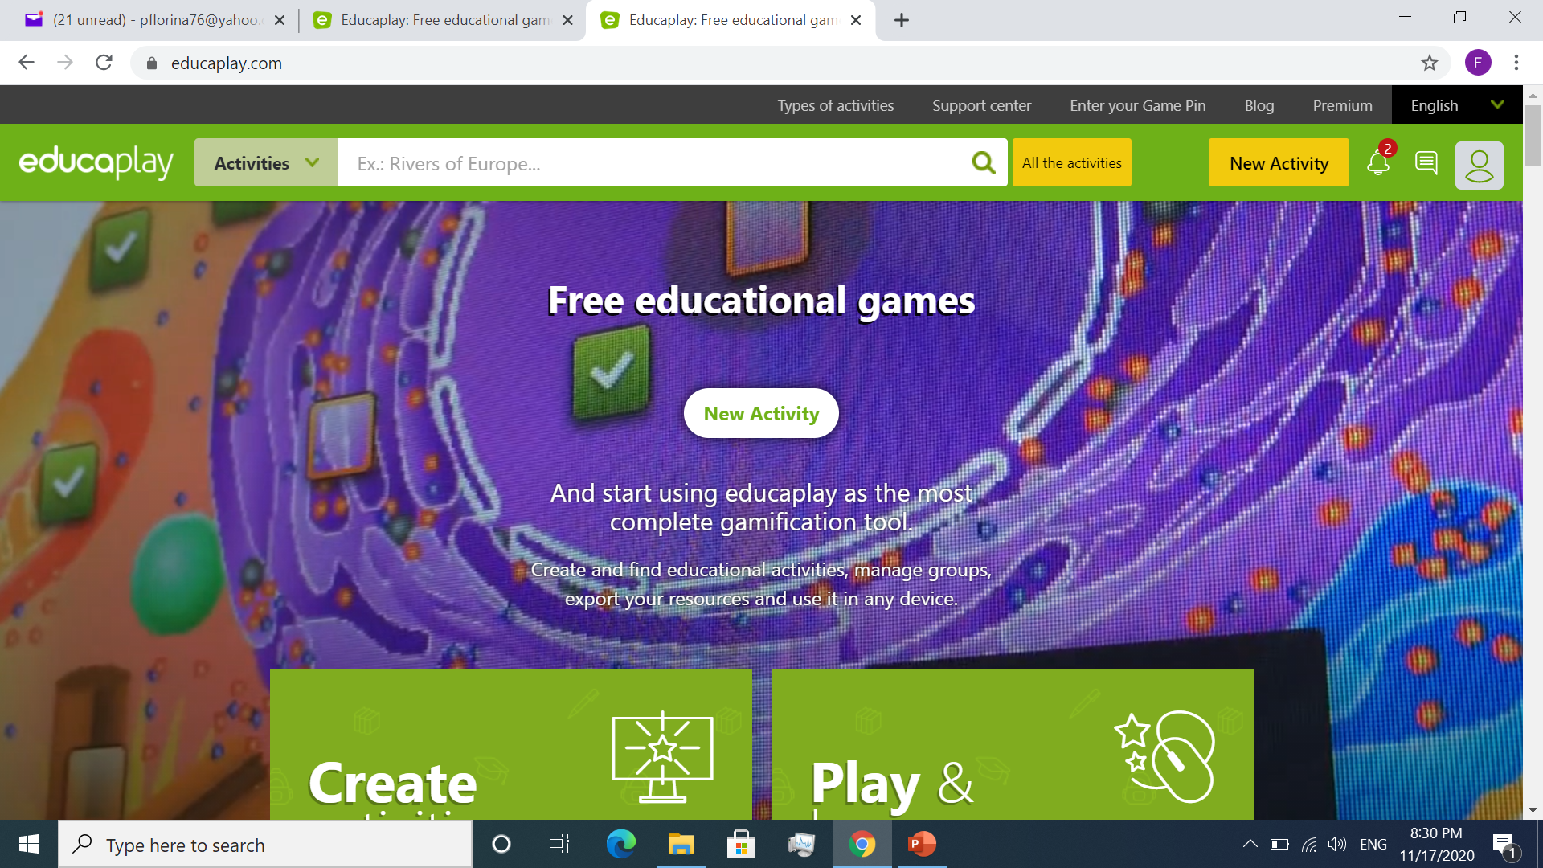
What is Educaplay?
A platform that allows teachers to create their own multimedia teaching activities.

Slide 3
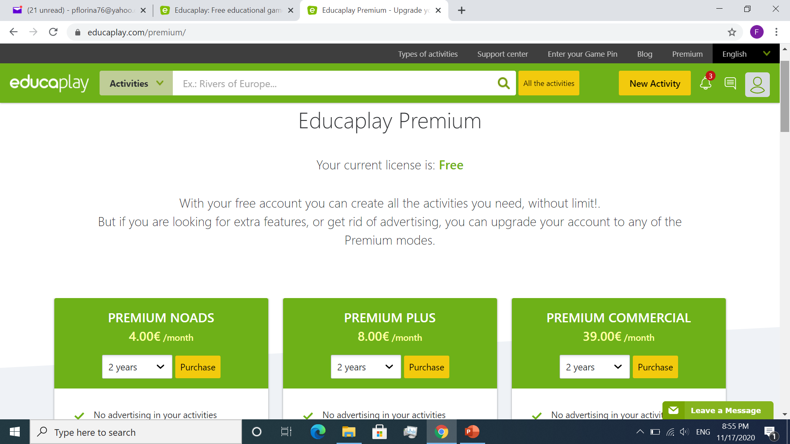
Is Educaplay free?
You can use a free version to create all the activities you need, without limit.
If you want extra features or to get rid of advertising, you can upgrade your account to one of the Premium modes.

Slide 4
How can you use Educaplay?
go to educaplay.com site
create a free account or sign up with a Google account
search activities in a catalogue with all kinds of subjects and levels…
or create your own interactive activities.
Create your own activities:
turn one of the activities in your textbook or workbook into an interactive activity…
or create a totally new activity, in accordance with your students’ needs and the topic of your lesson.

Slide 5
What can you use Educaplay activities for?
You can create Educaplay warm-up activities.
You can use them during the lead-in stage, to raise students’ interest in the topic of the lesson.
You can use them for vocabulary and grammar practice.
You can create exercises to check reading or listening comprehension.
You can use them to create interactive Homework.
You can use them for evaluation.
Etc.

Slide 6
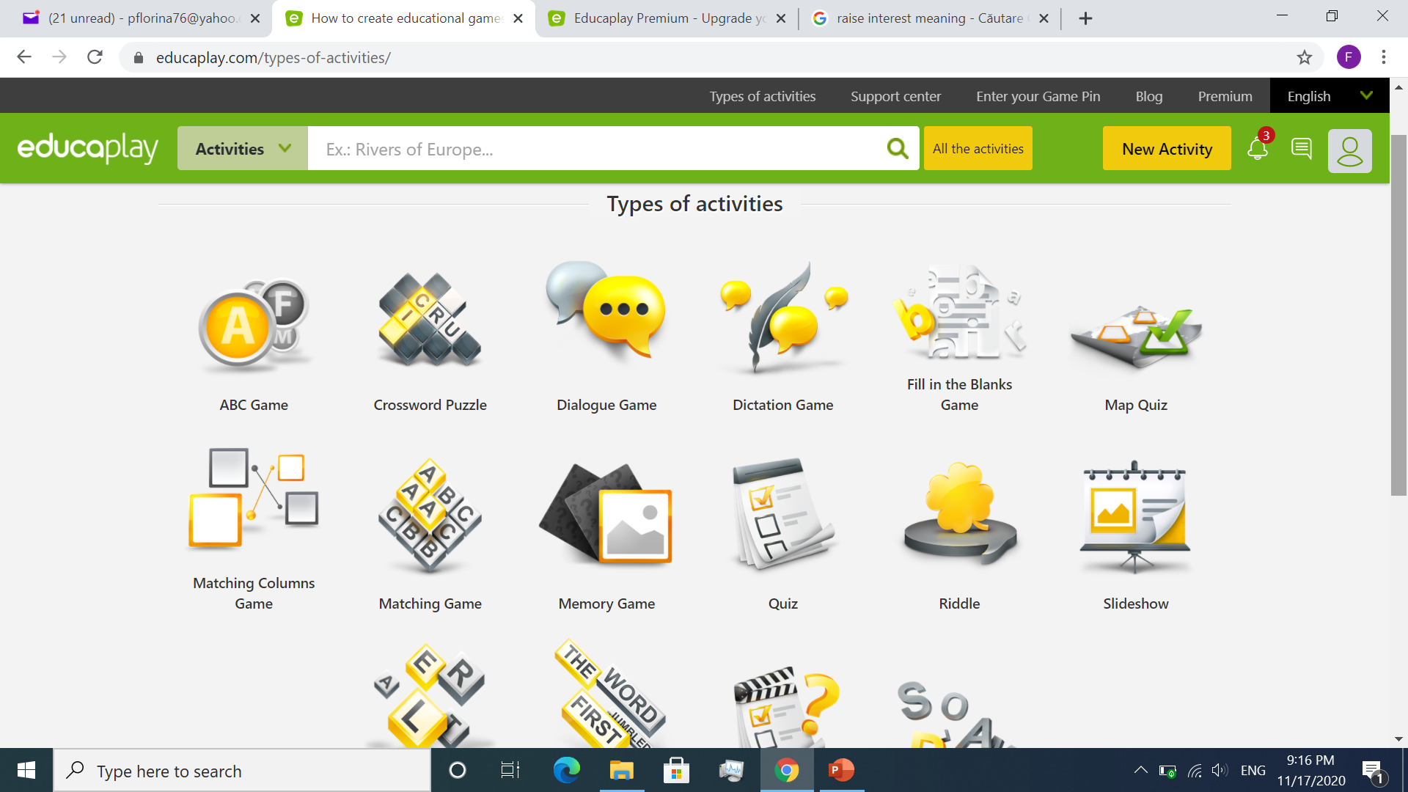
What are the available types of activities?
Riddles
Fill in the Blanks Games
Crossword Puzzles
Dialogue Games
Unscramble Letters Games
Unscramble Words Games
Matching Games
Word Search Puzzles Quizzes
Map Quizzes
Slideshows
Video Quizzes
Matching Columns Games
Memory Games
ABC Games

Slide 7
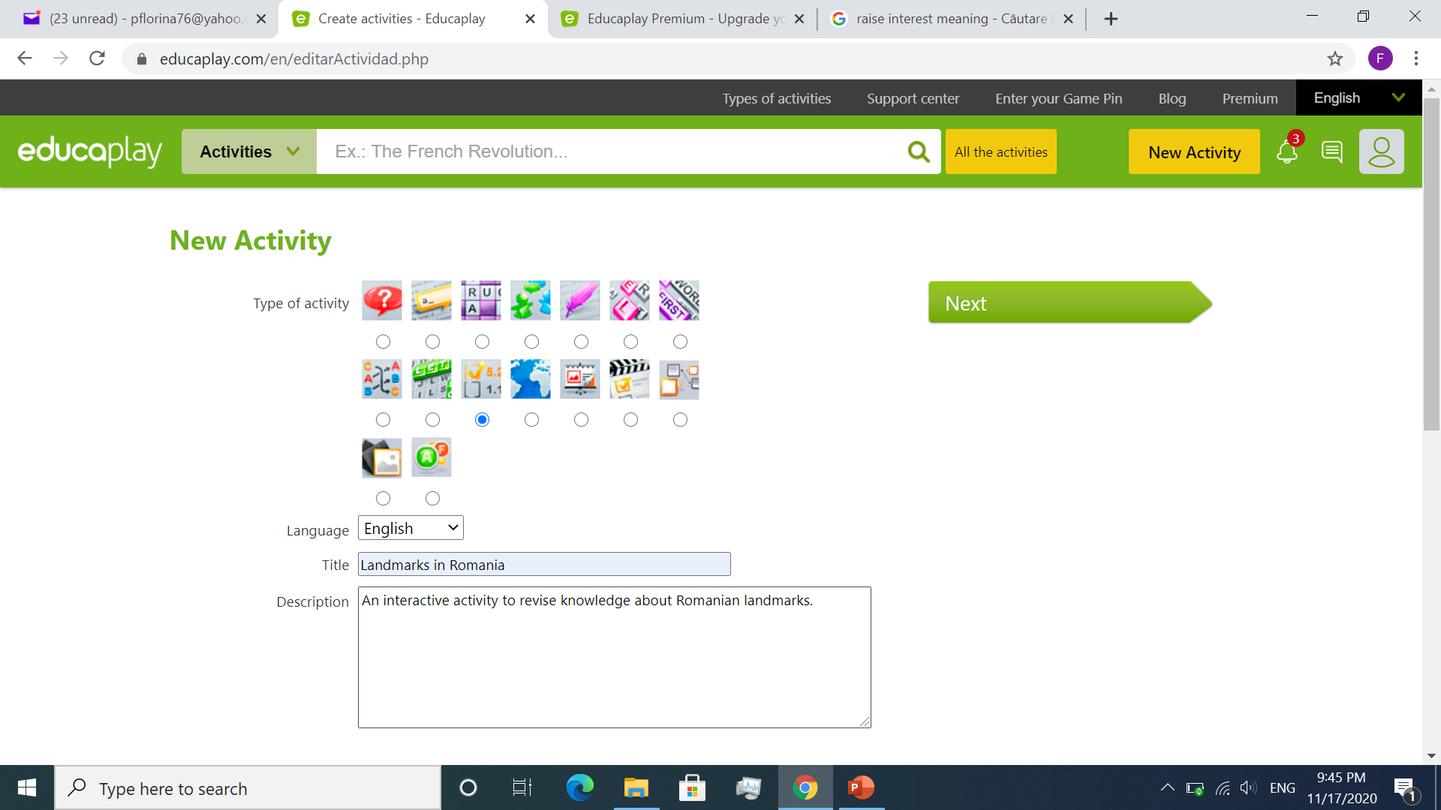
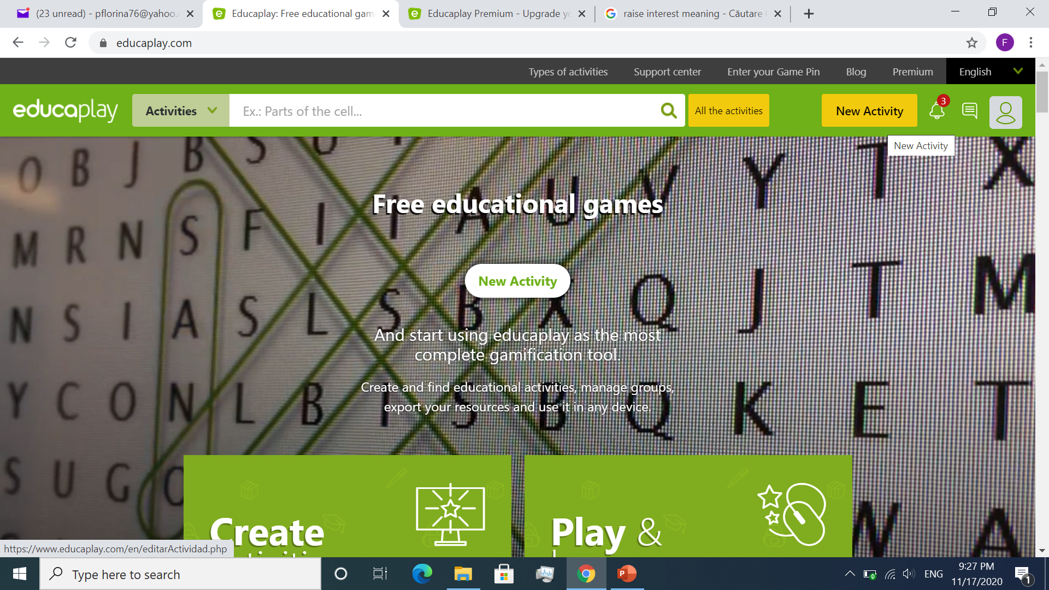
How can you create Educaplay activities?
2. Select the type of activity and fill in the required fields.
1. Click on “New Activity”

Slide 8
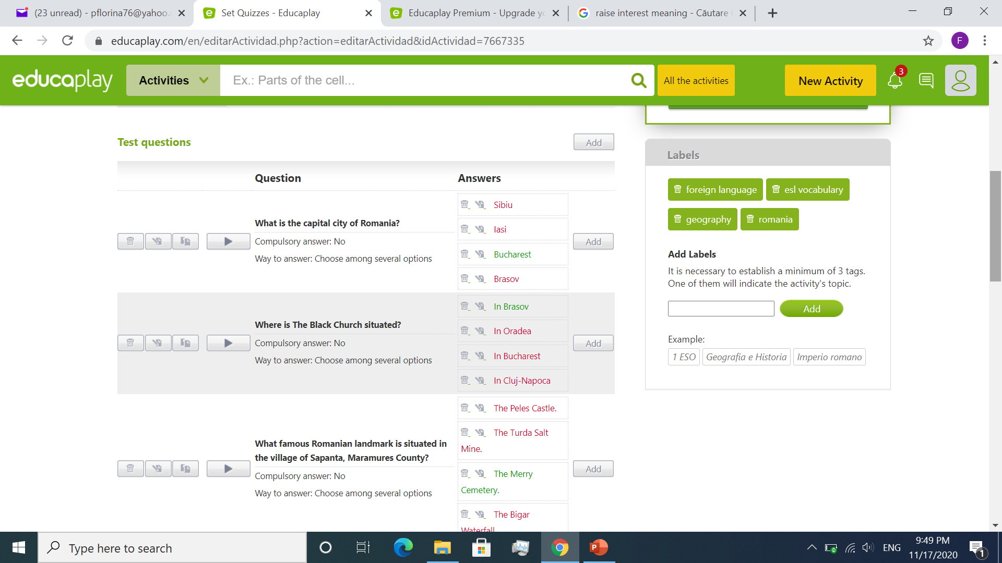
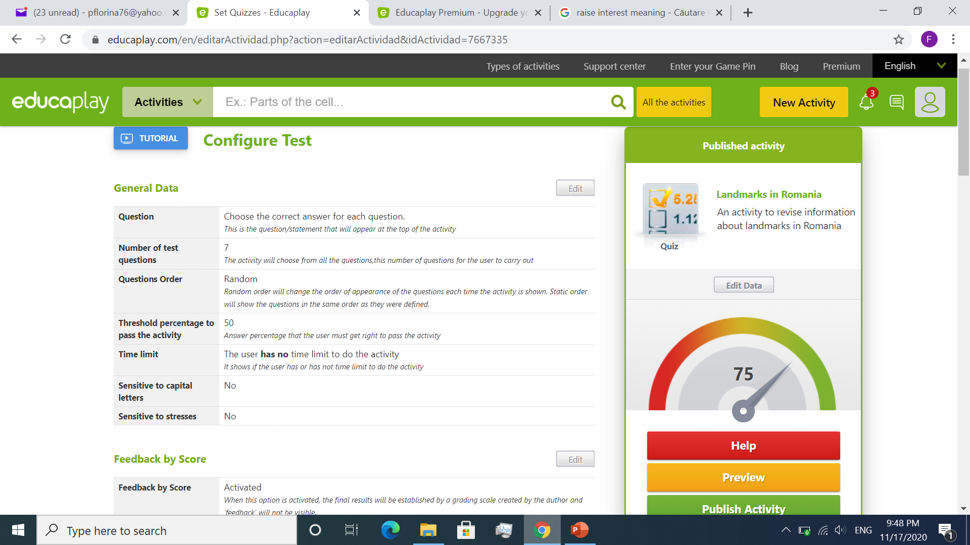
How can you create Educaplay activities?
4. Write the items and the answers.
3. Configure the activity

Slide 9
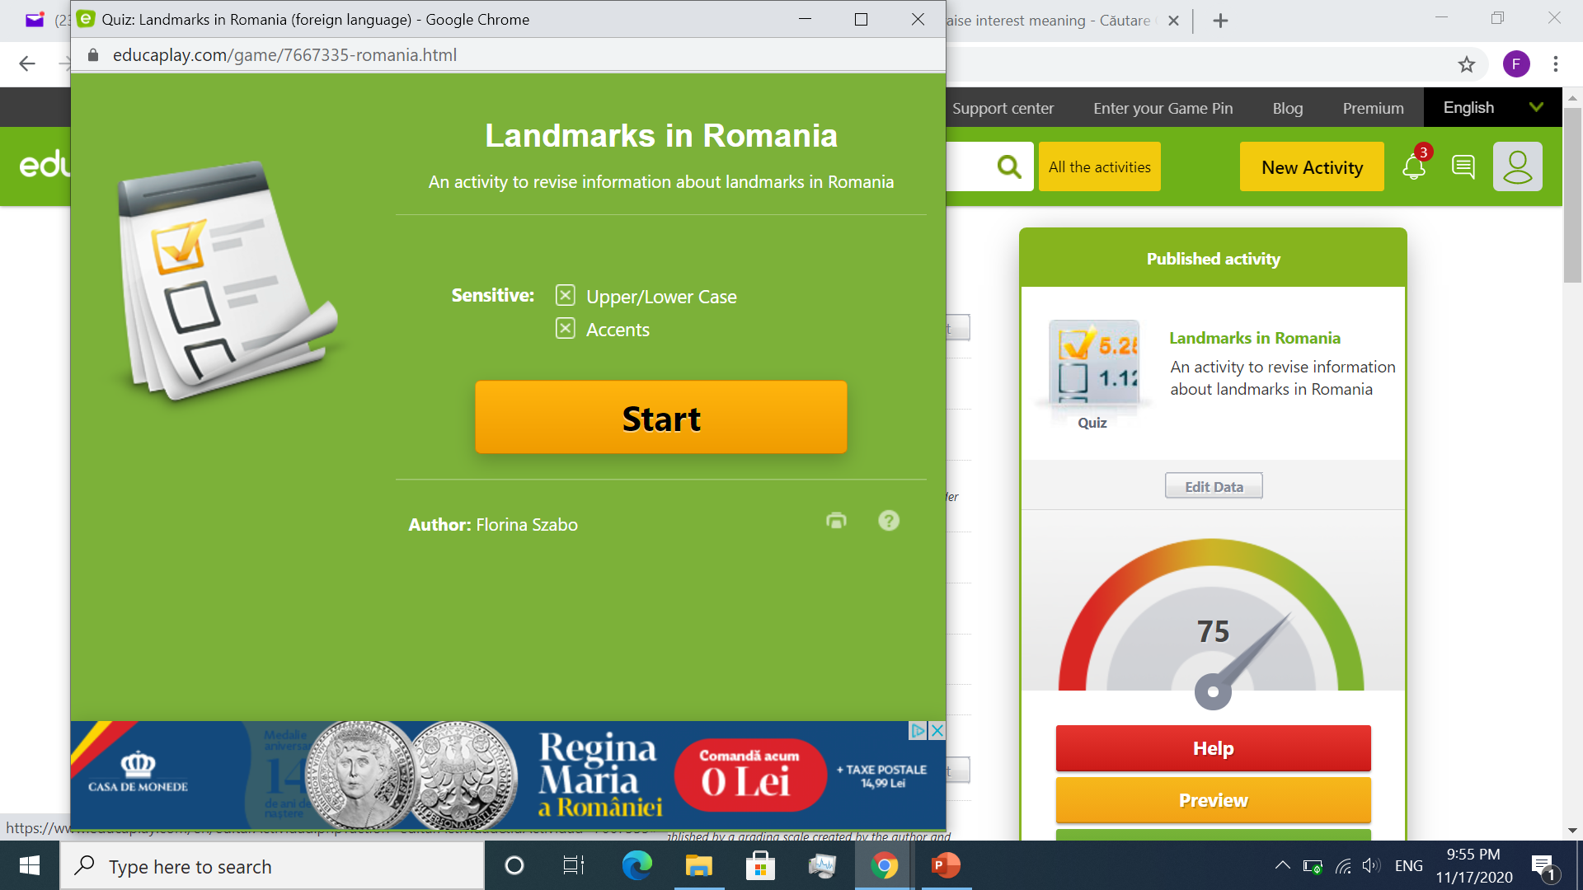
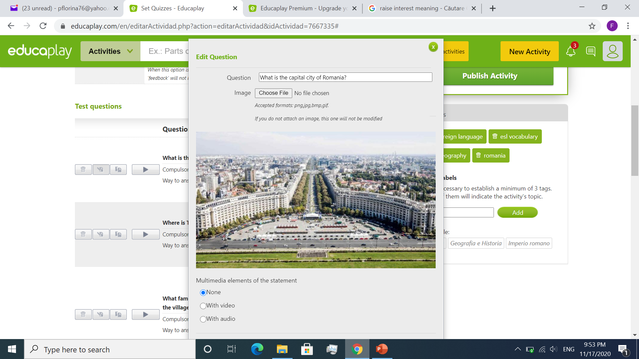
How can you create Educaplay activities?
6. Preview the activity.
5. Add images, videos, audio files
(optional).

Slide 10
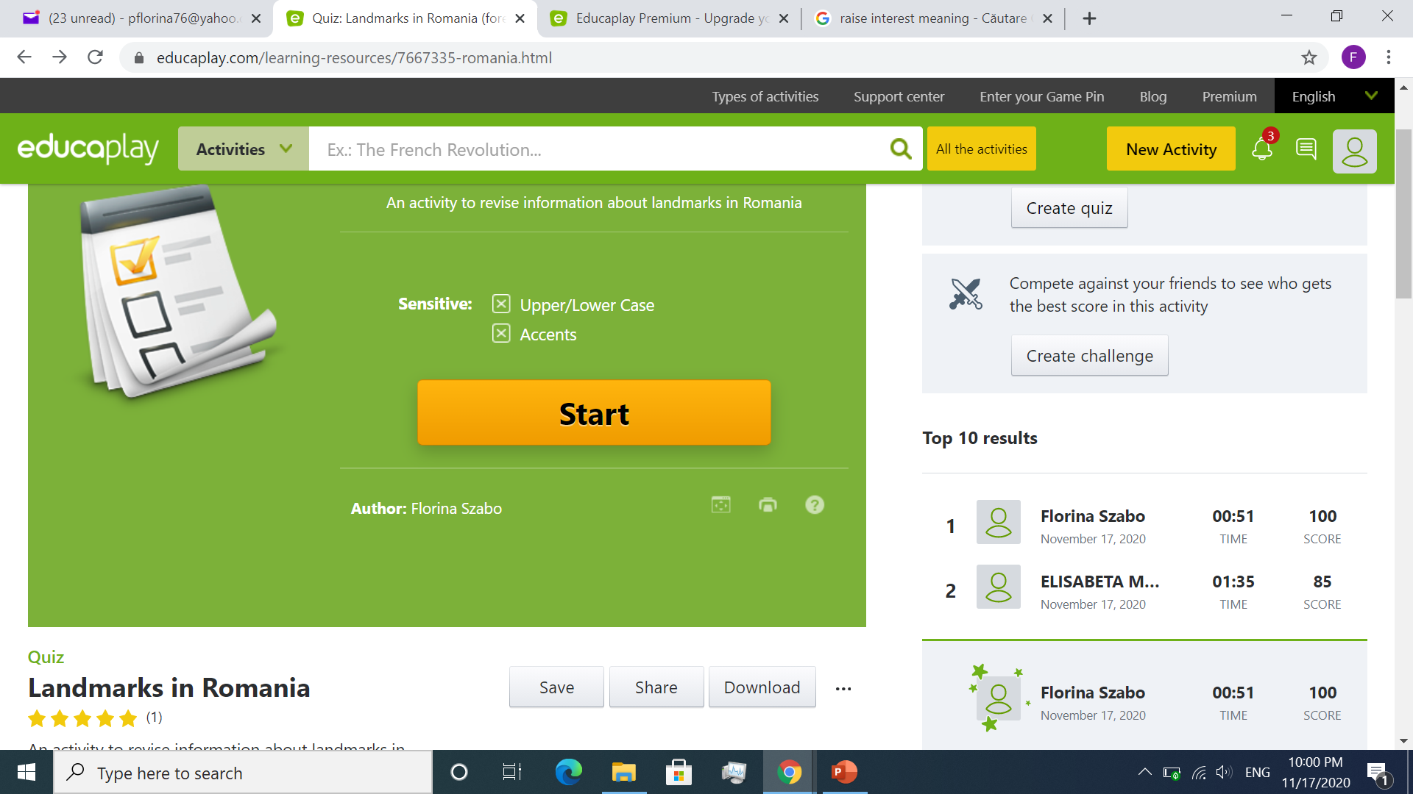
How can you create Educaplay activities?
7. Publish the activity and share it.

Slide 11
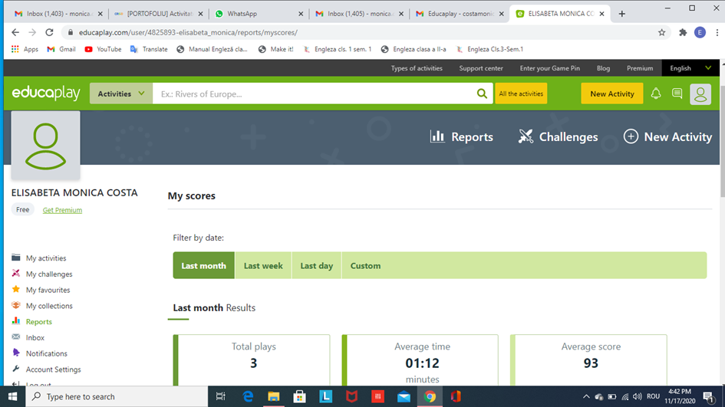
Scores and results
You can filter the results by date:
last month;
last week;
last day;
Custom.

Slide 12
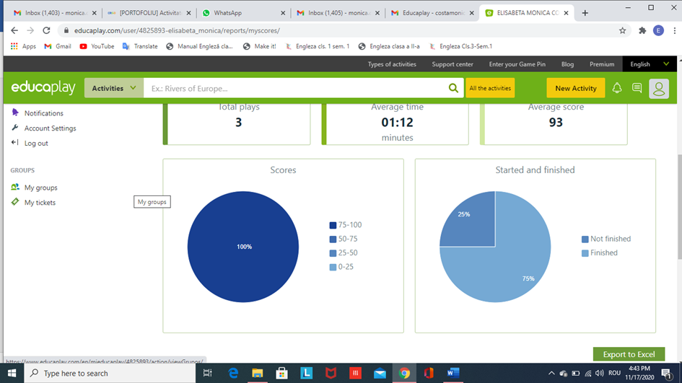
Scores and results
You can visualise the results as graphs.

Slide 13
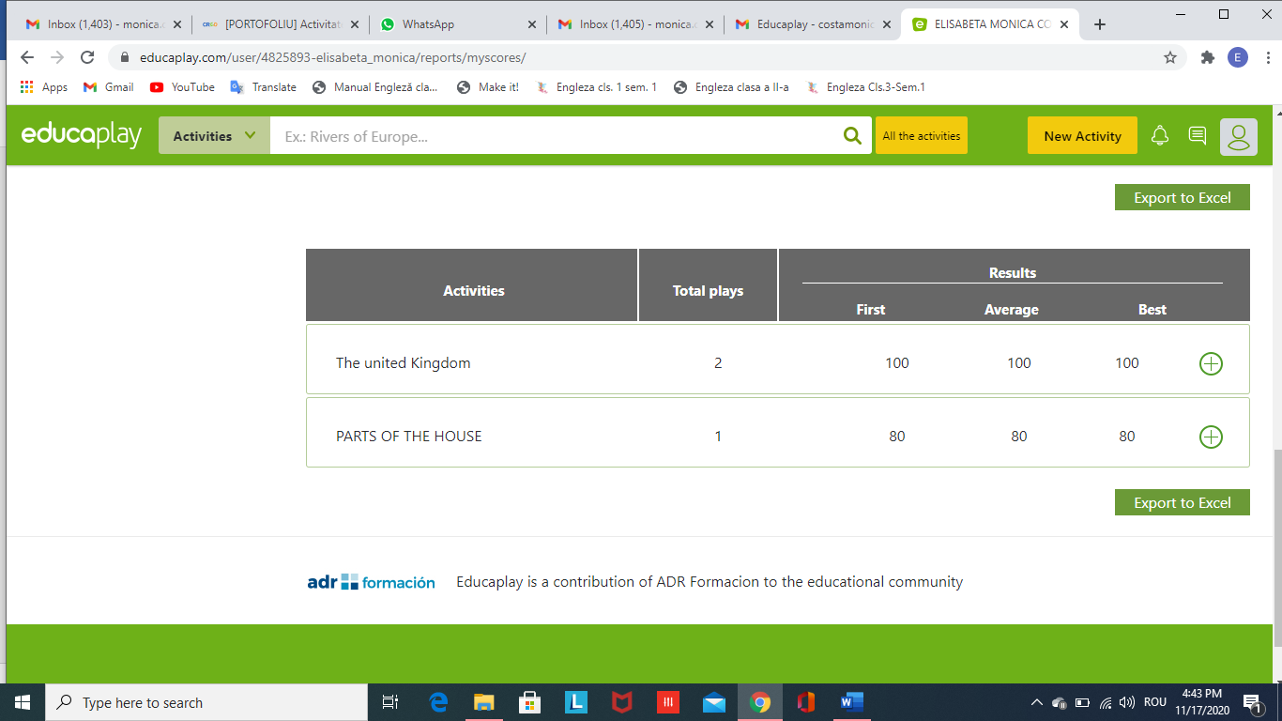
Scores and results
You can export the results to Excel.

Slide 14
And here is an example…
Activity title: Landmarks in Romania
5th grade
Textbook: Limba modernă 1 – Limba engleză, UniScan
Unit 1: Flash Time
https://www.educaplay.com/learning-resources/7667335-romania.html

Slide 15
Bibliography:
Dooley, J., 2017, Limba modernă 1 – Limba engleză, clasa a V-a, Express Publishing
www.educaplay.com, retrieved on 17th November 2020

